Slide 1

Machine Learning Is Learning Feasible?
Prof.Shuyuan Yang, Zhixi Feng
E-mail： syyang@xidianedu.cn
zxfeng@xidian.edu.cn

Slide 2
Contents
Is learning feasible?

Slide 3
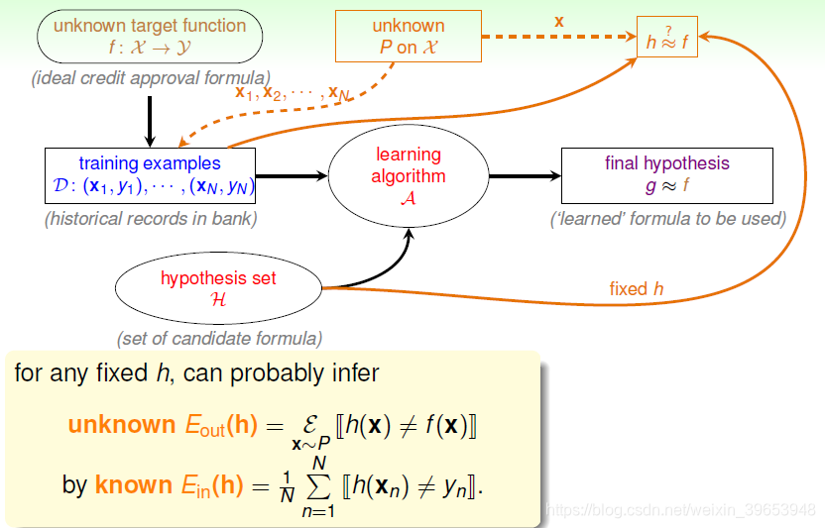
Learning？

Slide 4
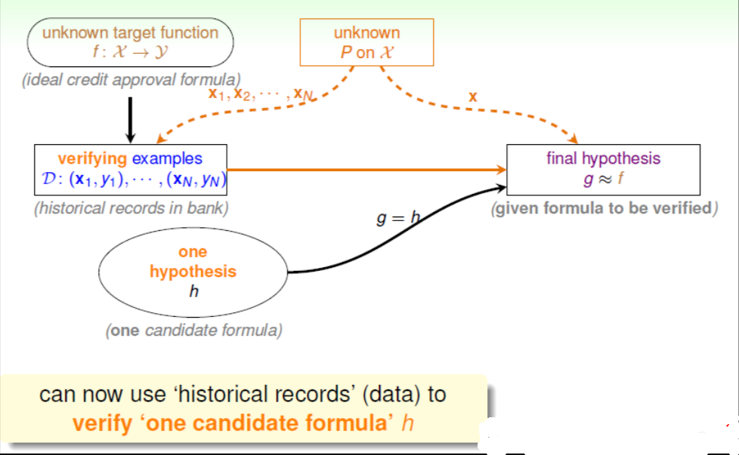
Learning？

Slide 5
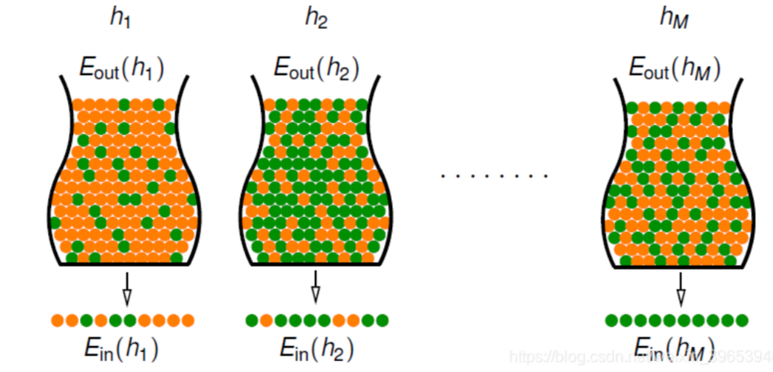
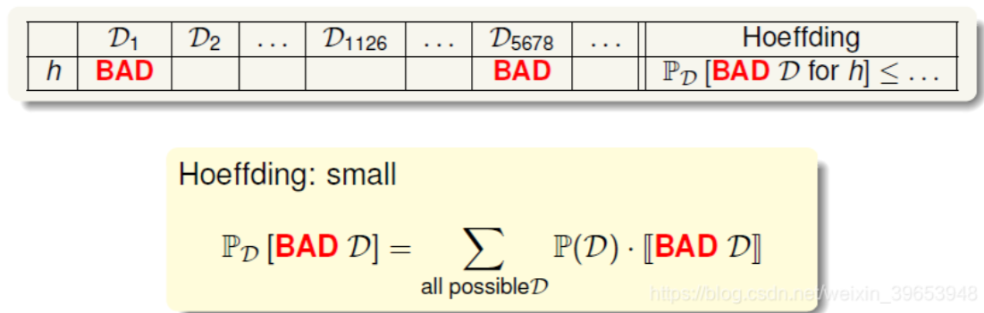
Learning？

Slide 6
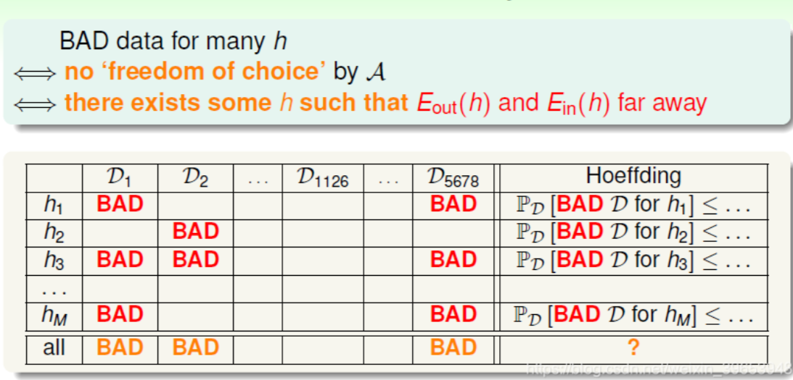
Learning？

Slide 7
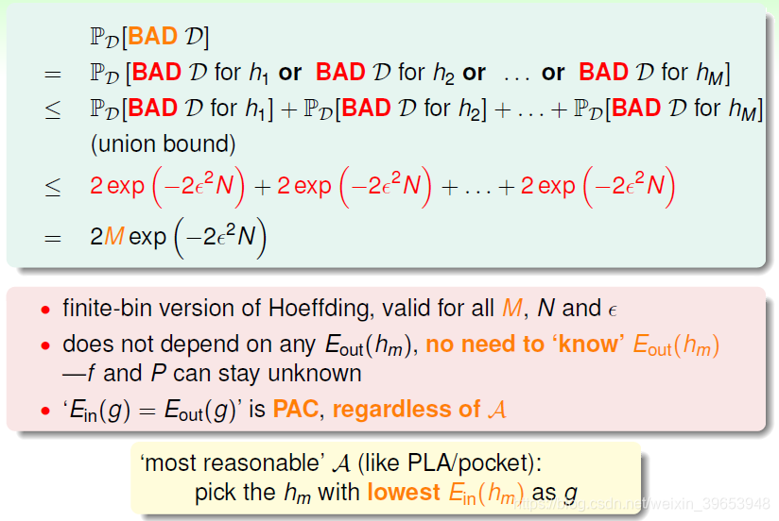
Learning？

Slide 8
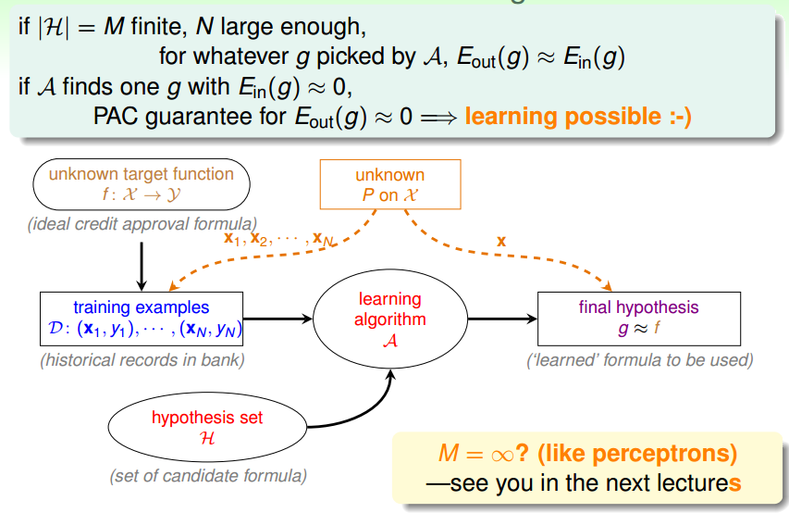
Learning？

Slide 9
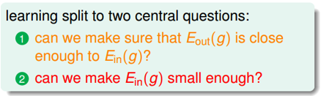
Two Central Questions

Slide 10
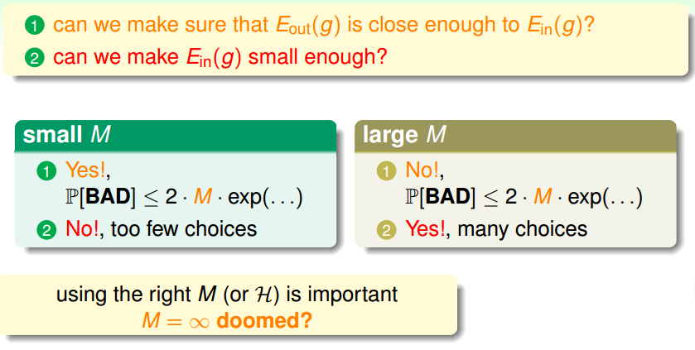
Trade-off on M

Slide 11
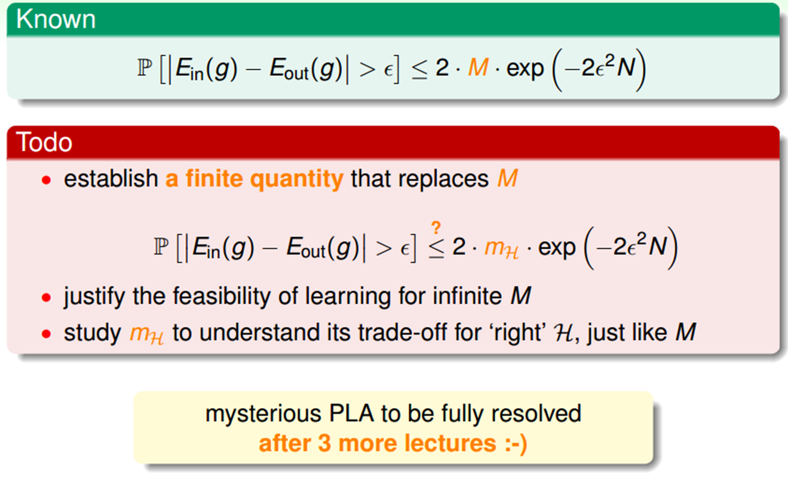
Preview

Slide 12
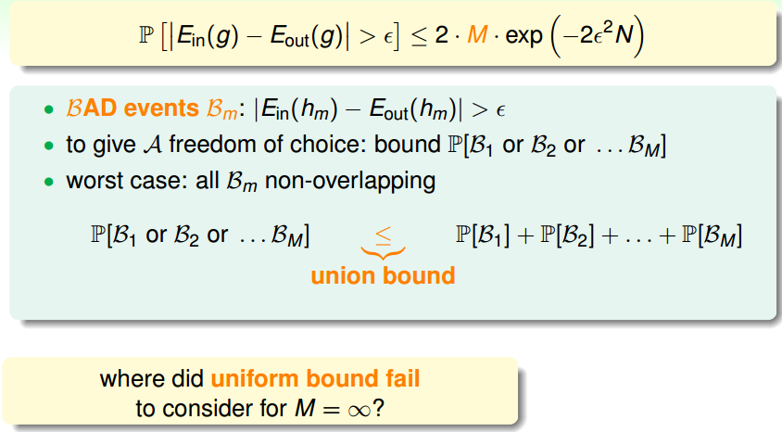
Where Did M Come From?

Slide 13
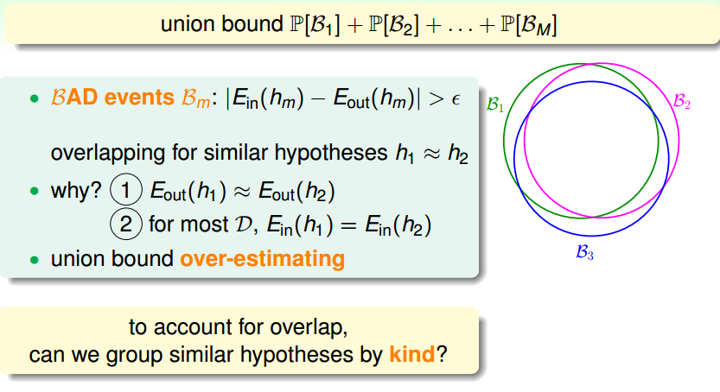
Where Did M Come From?

Slide 14
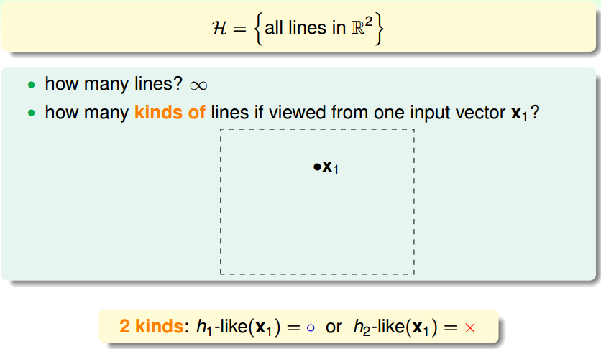
How Many Lines Are There? (1/2)

Slide 15
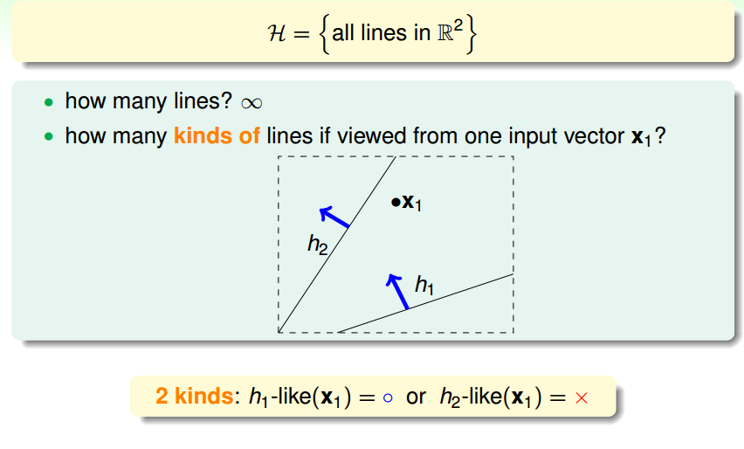
How Many Lines Are There? (1/2)

Slide 16
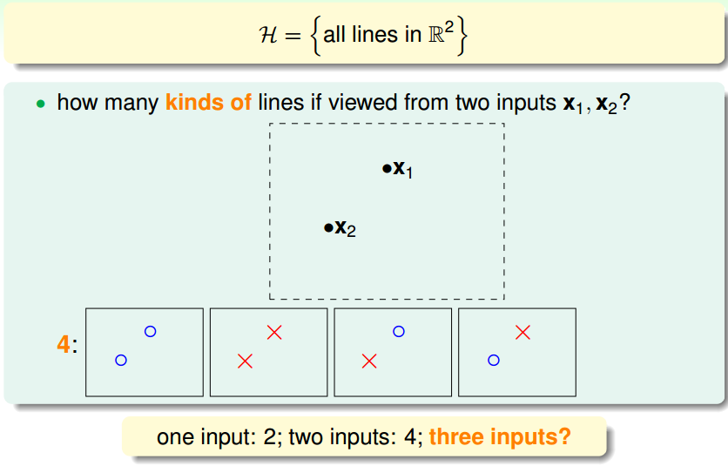
How Many Lines Are There? (2/2)

Slide 17
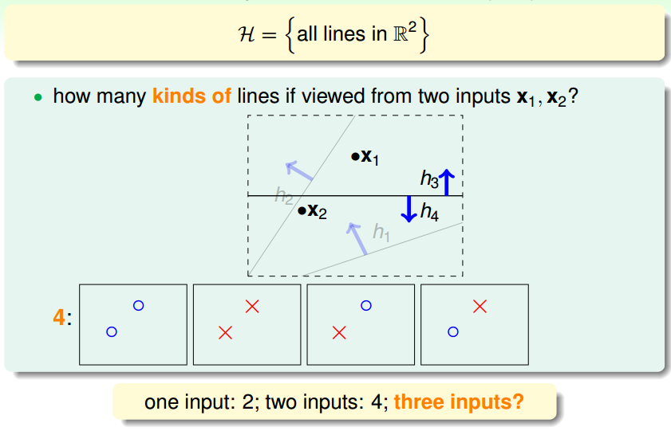
How Many Lines Are There? (2/2)

Slide 18
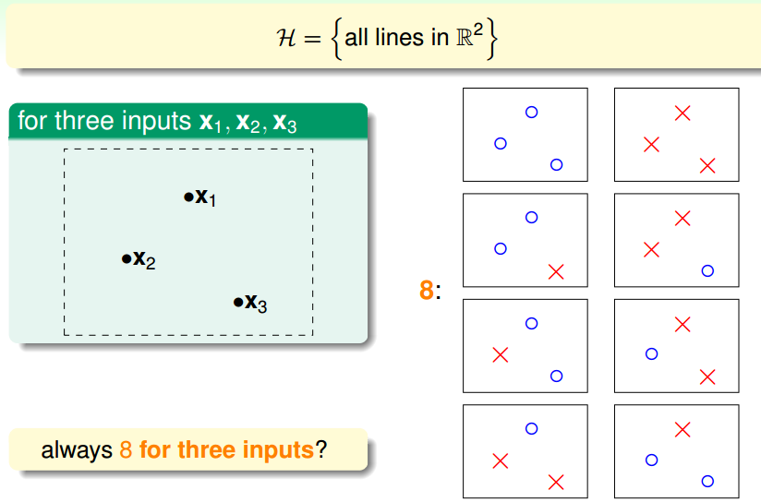
How Many Kinds of Lines for Three Inputs? (1/2)

Slide 19
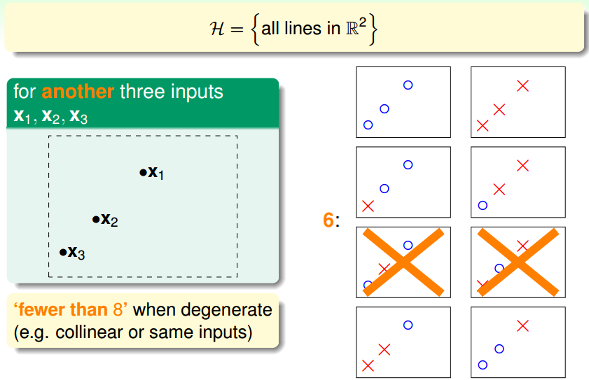
How Many Kinds of Lines for Three Inputs? (2/2)

Slide 20
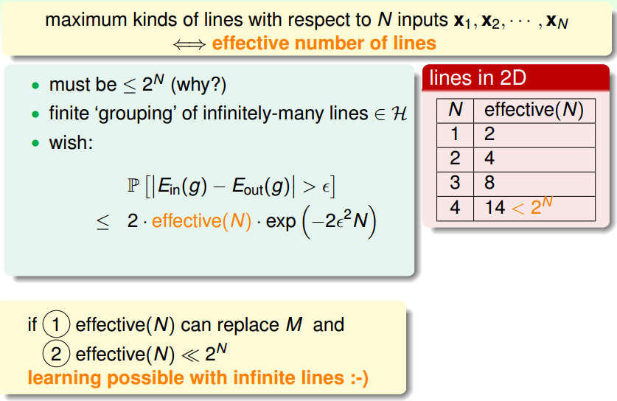
Effective Number of Lines

Slide 21
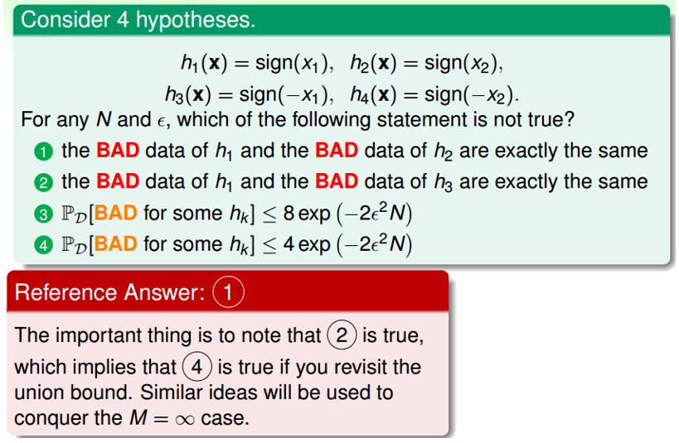
Fun Time

Slide 22
Fun Time

Slide 23
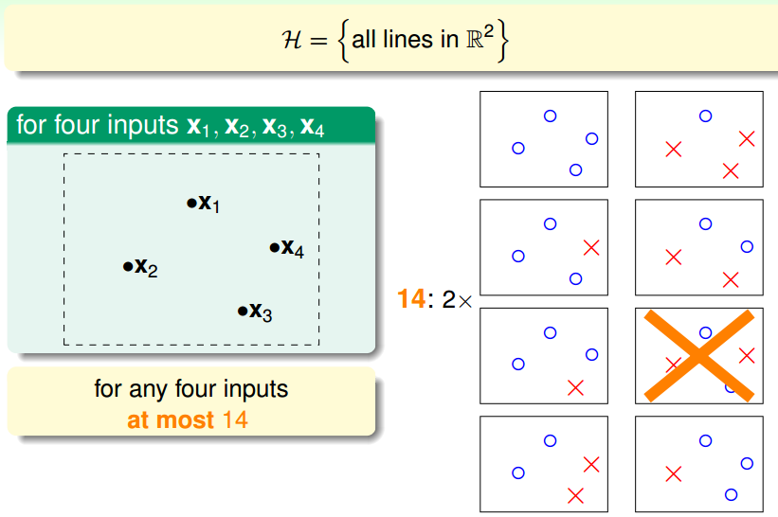
How Many Kinds of Lines for Four Inputs?

Slide 24
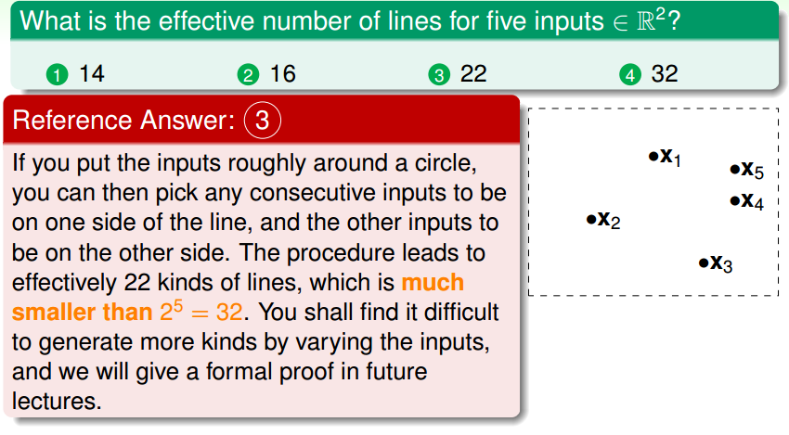
Fun Time

Slide 25
Fun Time

Slide 26
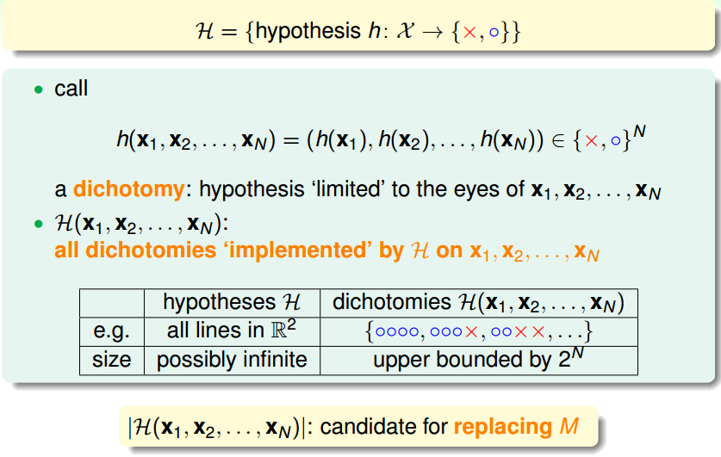
Dichotomies: Mini-hypotheses

Slide 27
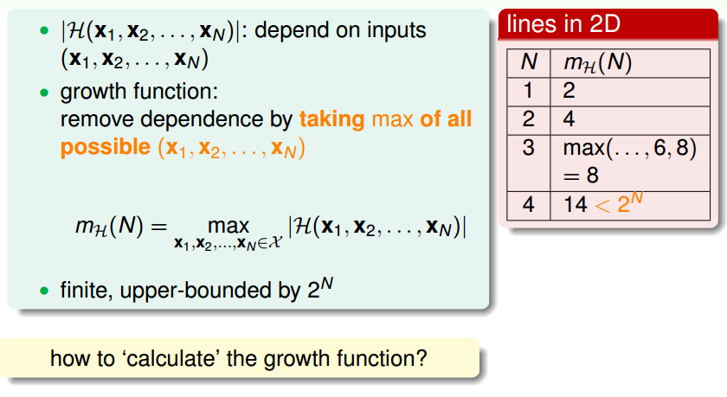
Growth Function

Slide 28
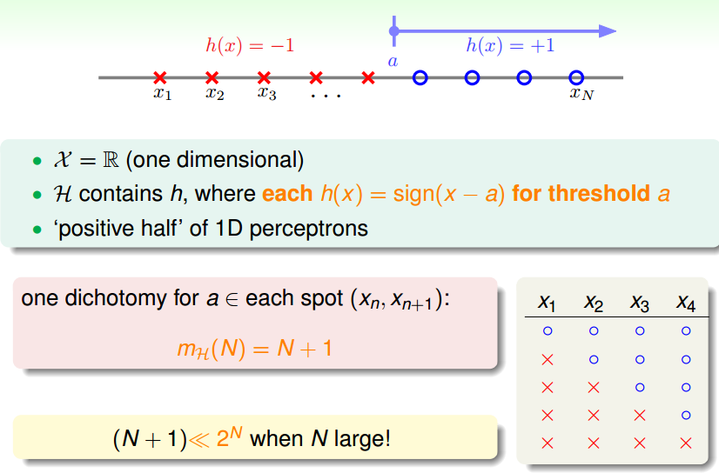
Growth Function for Positive Rays

Slide 29
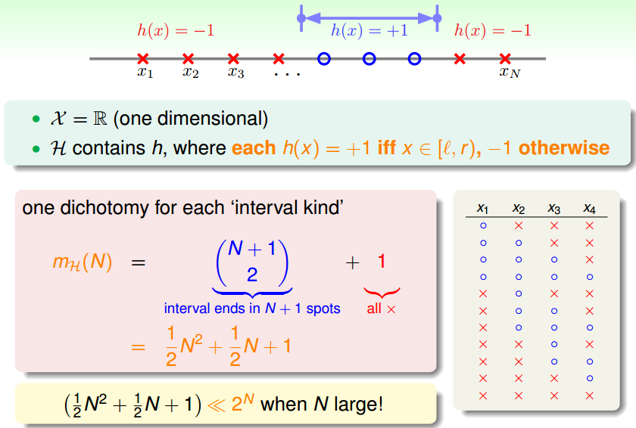
Growth Function for Positive Intervals

Slide 30
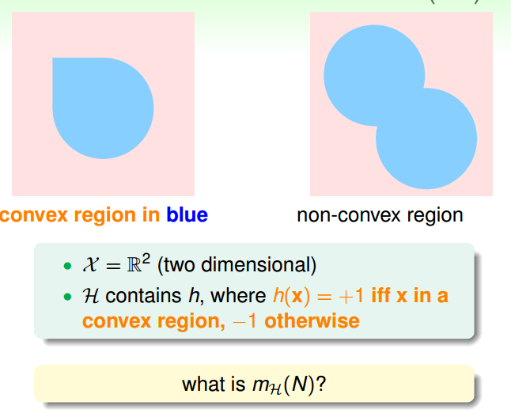
Growth Function for Convex Sets(1/2)

Slide 31
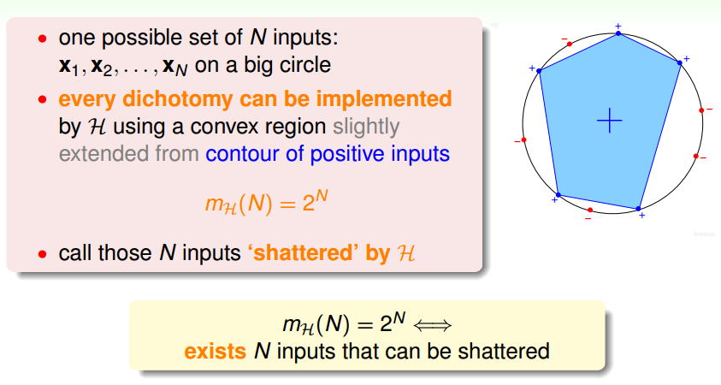
Growth Function for Convex Sets(2/2)

Slide 32
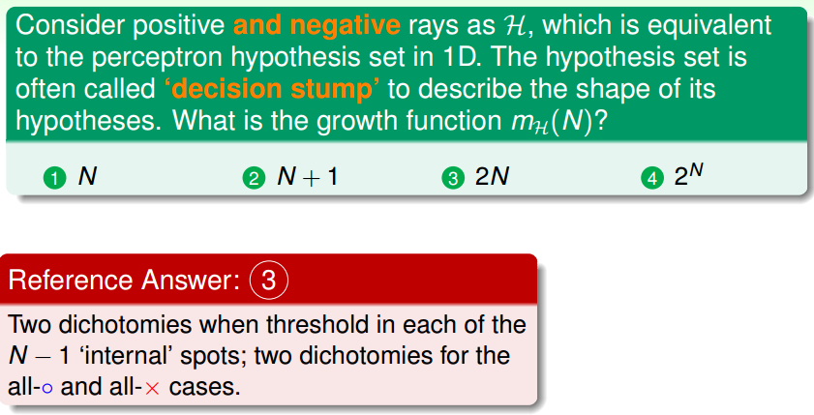
Fun Time

Slide 33
Fun Time

Slide 34
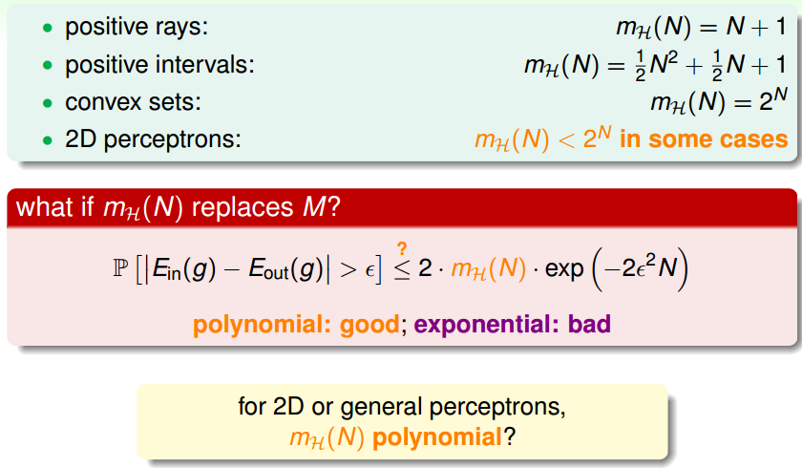
The Four Growth Functions

Slide 35
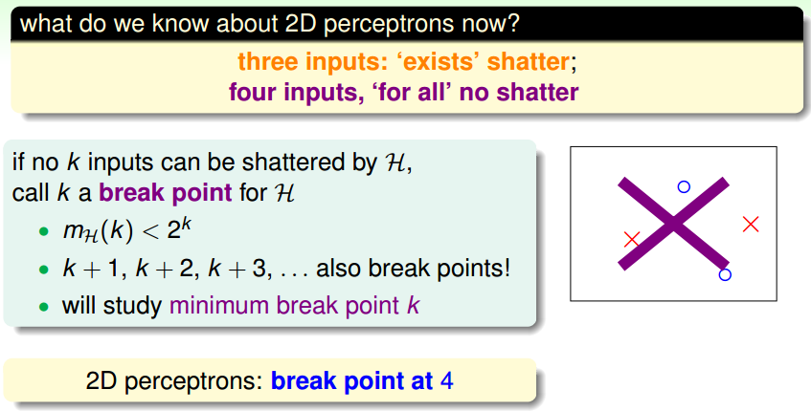
Break Point of H

Slide 36
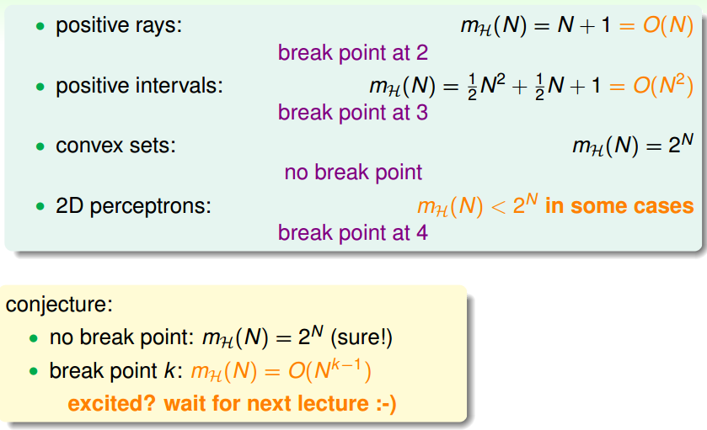
The Four Break Points

Slide 37
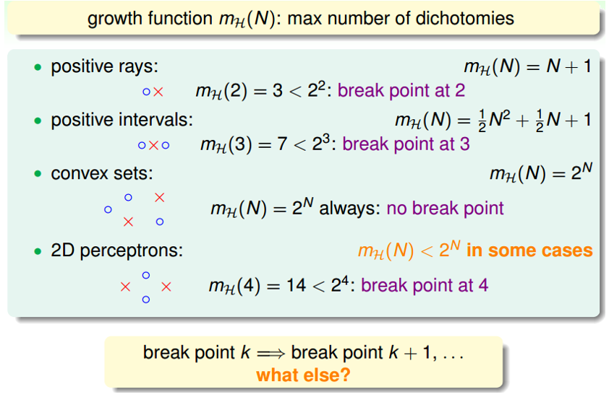
The Four Break Points

Slide 38
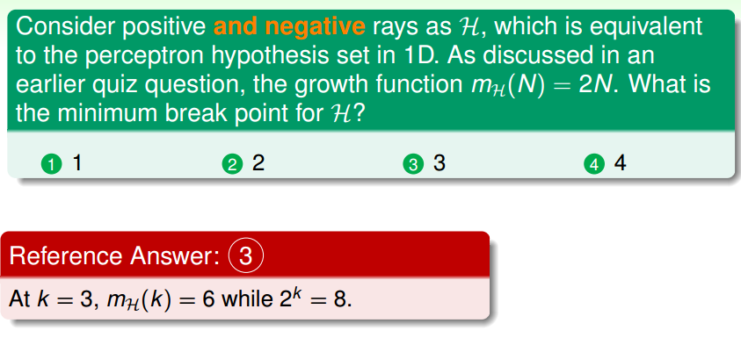
Fun Time

Slide 39
Fun Time

Slide 40
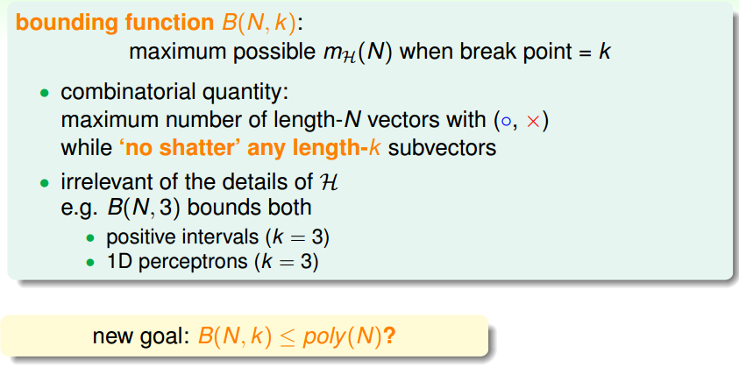
Bounding Function

Slide 41
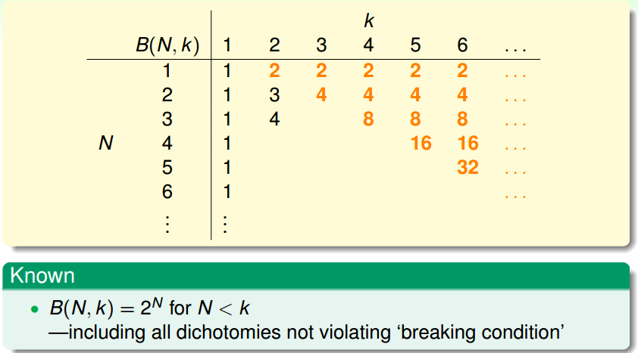
Table of Bounding Function

Slide 42
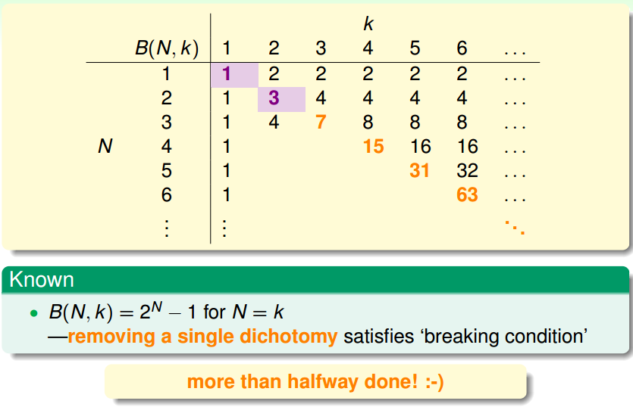
Table of Bounding Function

Slide 43
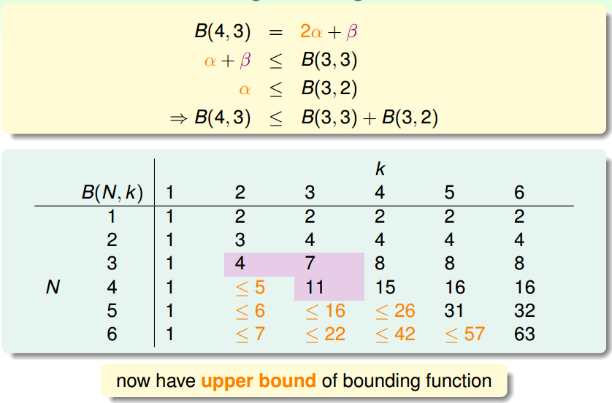
Table of Bounding Function

Slide 44
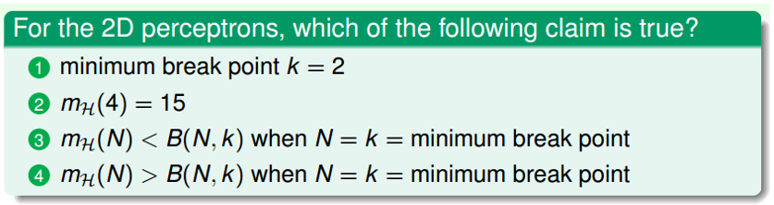
Q？

Slide 45
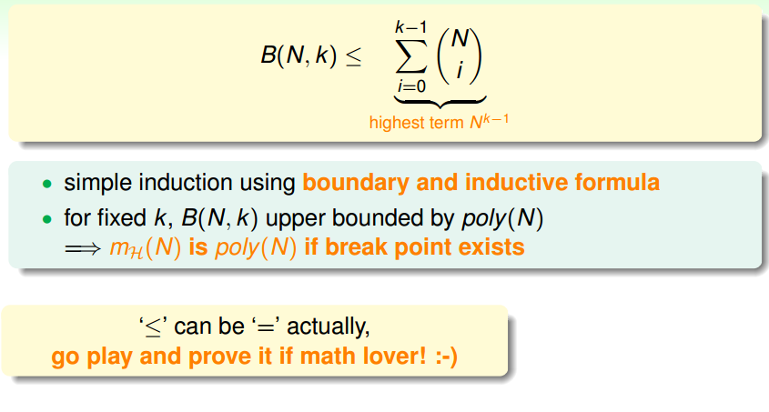
Bounding Function: The Theorem

Slide 46
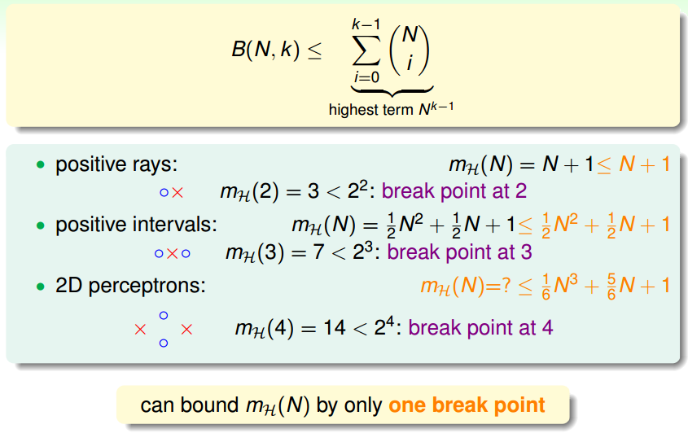
The Three Break Points

Slide 47
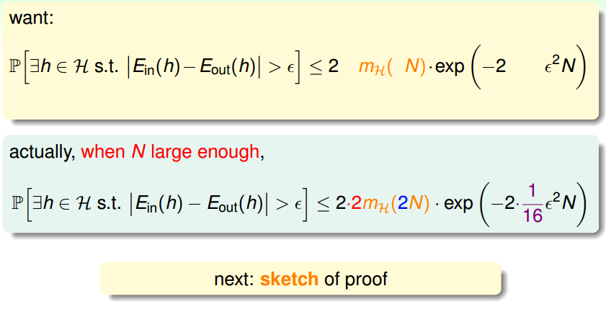
BAD Bound for General H

Slide 48
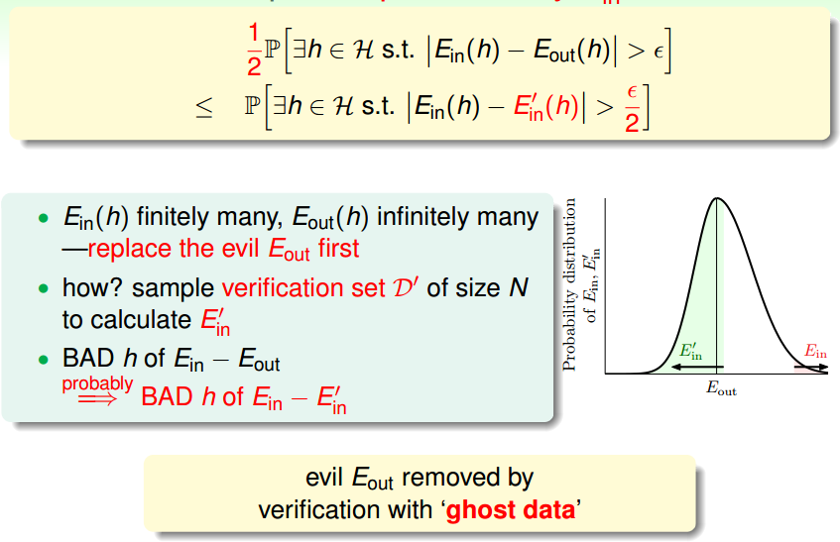
Step 1: Replace Eout by Ein

Slide 49
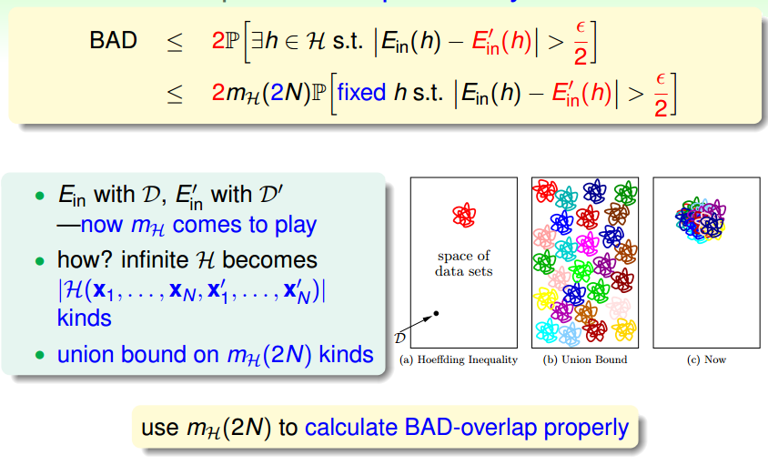
Step 2: Decompose H by Kind

Slide 50
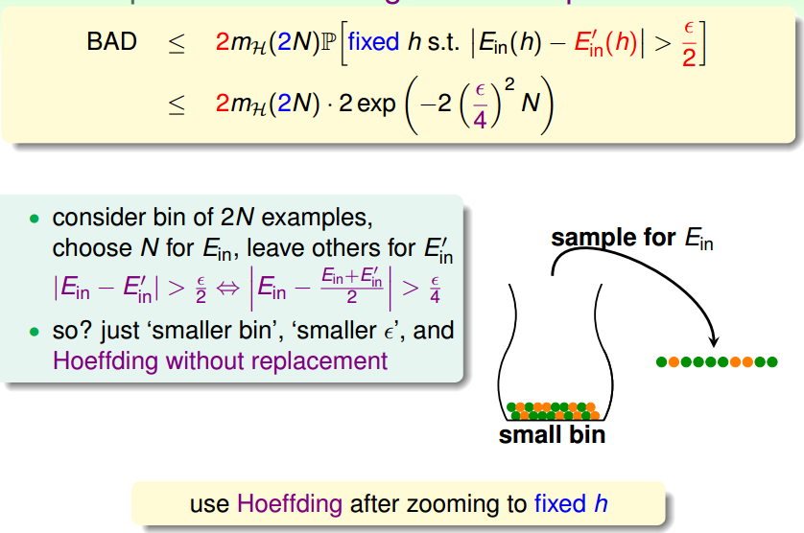
Step 3:Use Hoeffding without Replacement

Slide 51
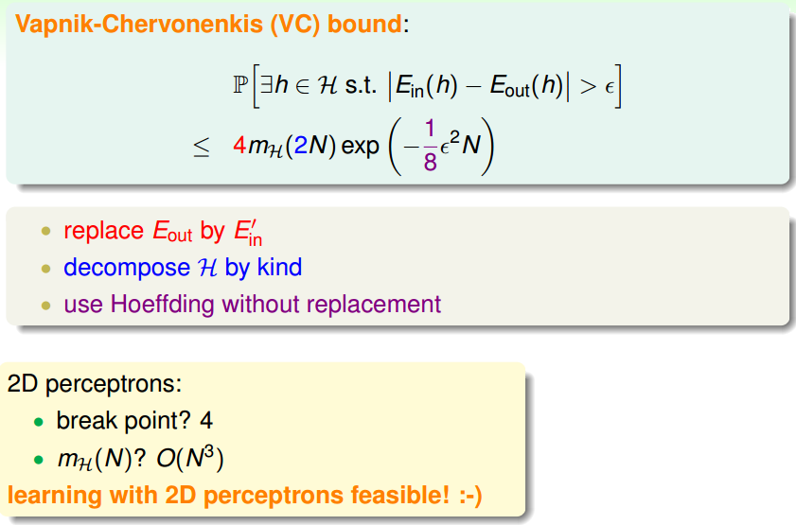

Slide 52
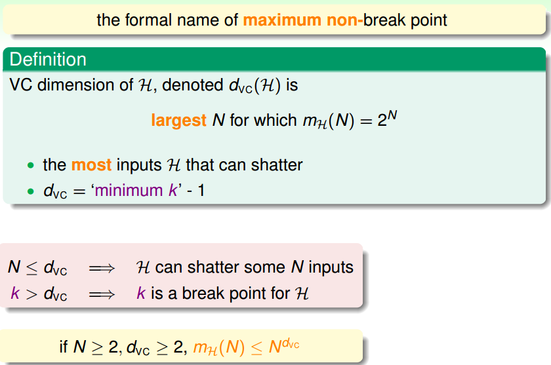
VC Dimension

Slide 53
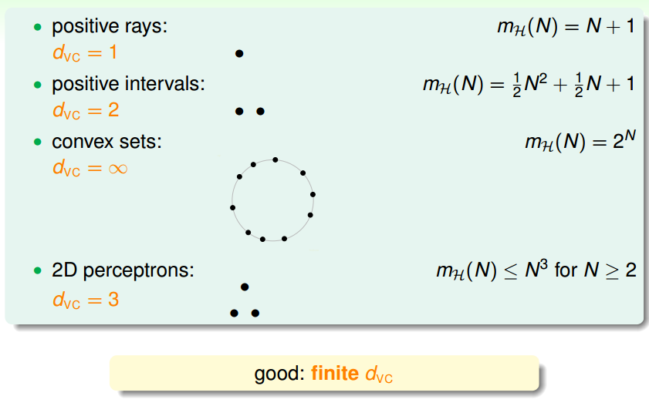
The Four VC Dimensions

Slide 54
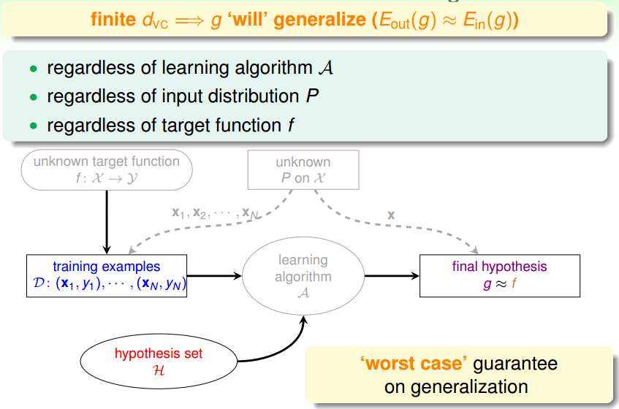
VC Dimension and Learning

Slide 55
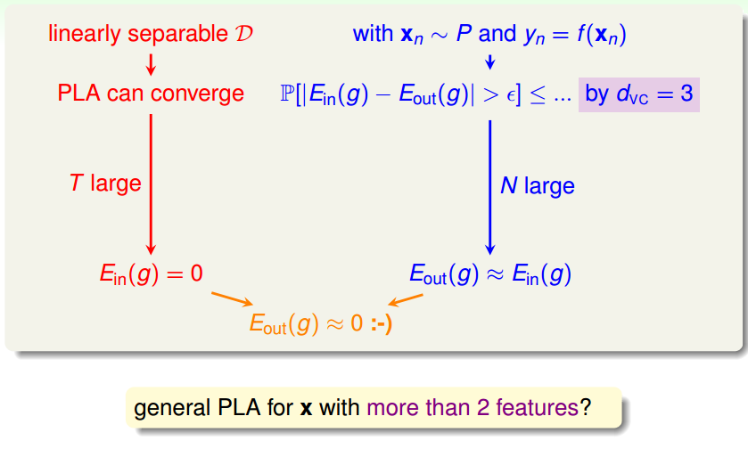
2D PLA Revisited

Slide 56

VC Dimension of Perceptrons

Slide 57

M and dVC

Slide 58

VC Bound Rephrase: Penalty for Model Complexity
Notes:
VC维度的意义1.VC维度可以代表假设集合的复杂程度，这也是我们引出VC维度的初衷（我们试图解决h（x）集合太大给我们带来的坏资料的问题）。VC维度越大，一个假设集合大小的上限函数就会增加假设集合的复杂程度会增大。2.VC维度还可以代表假设本身的复杂性，简单的例子就是我们的VC维度越高如2D的perceptrons的dvc==3而假设我们将VC维度上调为4的时候我们就能得到4个点的完全二分的集合。我们能够做出更为复杂的分割动作，也就是我们的单个模型拥有更为强大的分割能力！综上所述我们的假设集合与单个假设的复杂度都会随着VC维度的增加而增加从而变得更加的强大。
————————————————
版权声明：本文为CSDN博主「量子智能龙哥」的原创文章，遵循CC 4.0 BY-SA版权协议，转载请附上原文出处链接及本声明。
原文链接：https://blog.csdn.net/qq_34993631/article/details/79200782

Slide 59

VC Bound Rephrase: Penalty for Model Complexity

Slide 60

THE VC Message

Slide 61



Slide 62

VC Bound Rephrase: Sample Complexity

Slide 63

Looseness of VC Bound

Slide 64

Q？

Slide 66

机器学习项目流程

Slide 67

机器学习一般步骤

Slide 68

机器学习一般步骤

